Slide 1

Mixture & Alligation
Placement Preparation
Aptitude & Reasoning
Prof. Krunal D. Vyas
Computer Engineering Department
krunal.vyas@darshan.ac.in
9601901005

Slide 2
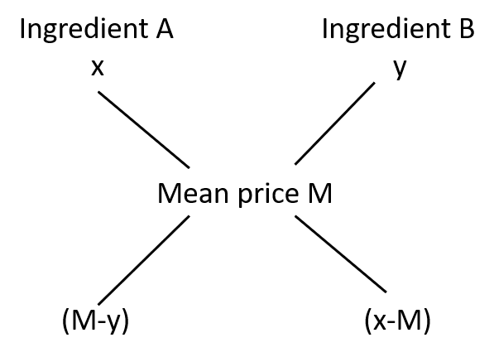
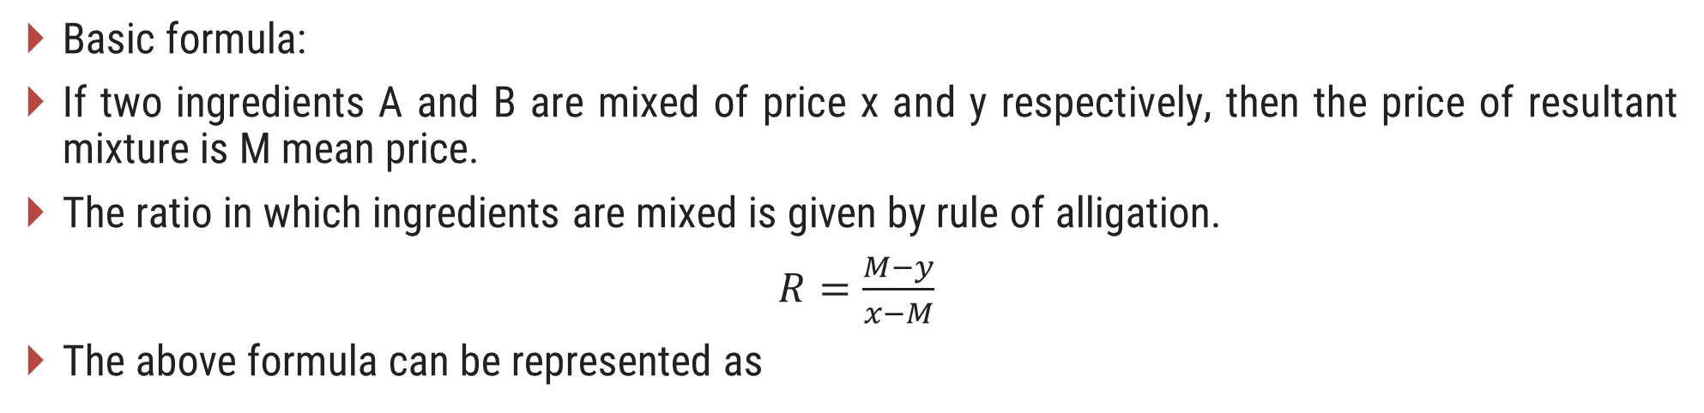
General Rule
Basic formula:
If two ingredients A and B are mixed of price x and y respectively, then the price of resultant mixture is M mean price.
The ratio in which ingredients are mixed is given by rule of alligation.
$R=\frac{M−y}{x−M}$
The above formula can be represented as

Slide 3
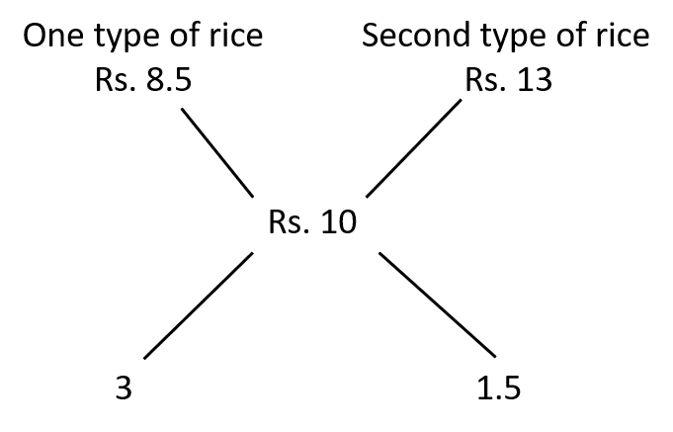
Examples
Example-1: In what ratio must rice costing Rs. 8.50 per kg be mixed with rice costing Rs. 13 per kg so that the mixture be worth Rs. 10 per kg?
Solution-1: Here, by cross connection formula, 10 - 8.5 = 1.5 & 13 -10 = 3 as shown below.
Required ratio = 3 : 1.5 = 2 : 1

Slide 4
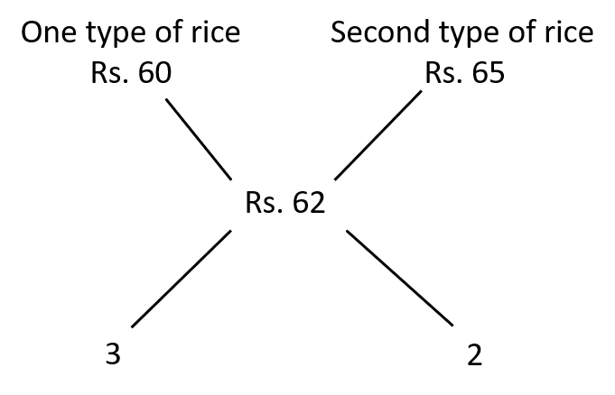
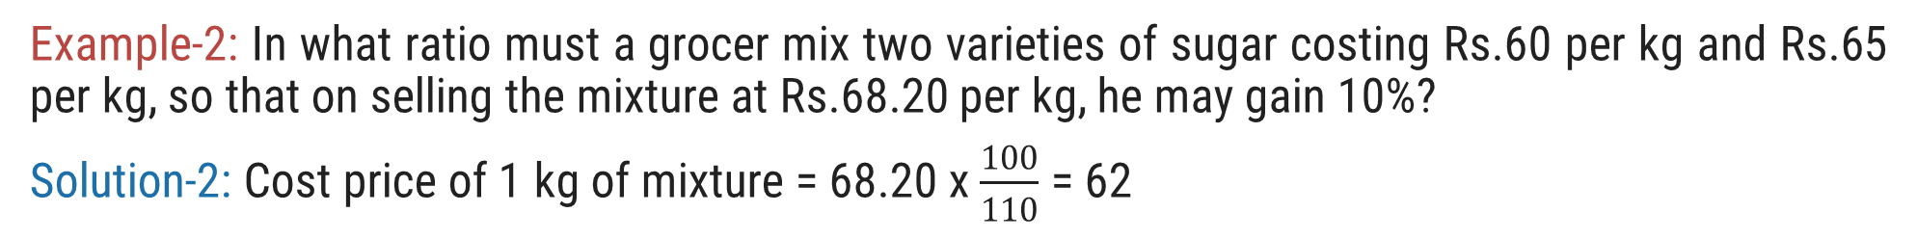
Examples
Example-2: In what ratio must a grocer mix two varieties of sugar costing Rs.60 per kg and Rs.65 per kg, so that on selling the mixture at Rs.68.20 per kg, he may gain 10%?
Solution-2: Cost price of 1 kg of mixture = 68.20 x $\frac{100}{110}$ = 62
Required ratio = 3 : 2

Slide 5
Mixture of more than two elements
These questions may seem to be a little tricky at first, but similar concept is applied repeatedly in order to calculate final ratio of ingredients when mixture contains more than two ingredients.
1. Take two ingredients in such a way that first ingredient is lower than the mean value and the other one is higher than mean value.
2. Calculate the ratio of ingredients.
3. Repeat for all possible pairs.
4. Final ratio is the ratio obtained from step-2 (if an ingredient is common in the ratios, add value for this particular ingredient)

Slide 6
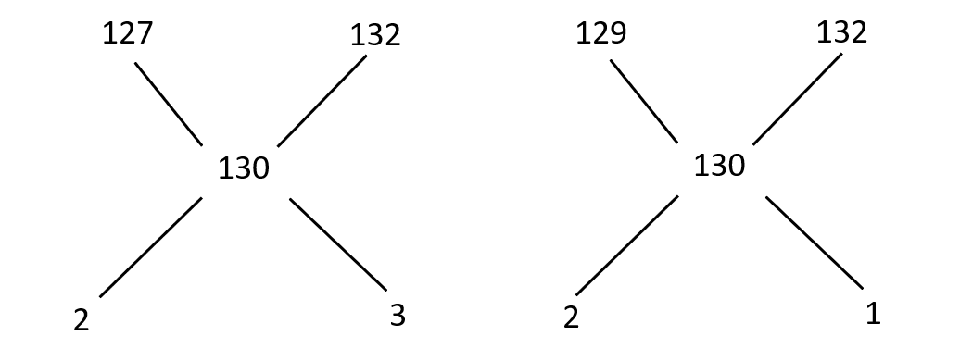
Examples
Example-3: Three types of Rice of Rs. 1.27, Rs. 1.29 and Rs. 1.32 per kg are mixed together to be sold at Rs. 1.30 per kg. In what ratio should this rice be mixed?
Solution-3: Here, we can convert fractional number into integer by simply multiply with 100 to each and every rupee and by cross connection formula, we will get ratio as shown below
Hence, final ratio is 2 : 2 : 3+1 = 2 : 2 : 4 = 1 : 1 : 2

Slide 7
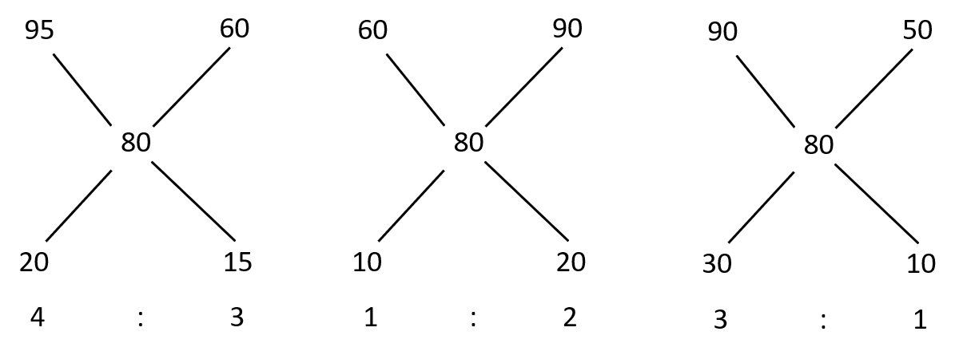
Examples
Example-4: How much a shop owner mixture 4 types of rice worth Rs. 95, Rs. 60, Rs. 90 & Rs. 50 per kg so that he can make the mixture of these rice worth Rs. 80 per kg.
Solution-4: Here, we have to mix two mixtures at a time with total three different types of mixing in which one quantity should remain common in every beside mixture, like 95 & 60, 60 & 90 and 90 & 50 as shown in below.
Hence, final ratio is 4 : 3+1 : 2+3 : 1 = 4 : 4 : 5 : 1

Slide 8
Exercise
Ex-1: Two alloys are both made up of copper and tin. The ratio of copper and tin in the first alloy is 1 : 3 and in the second alloy is 2 : 5. In what ratio should the two alloys be mixed to obtain a new alloy in which ratio of tin and copper be 8 : 3?
Ex-2: 1050 rupees are distributed among 1400 males and females such that each male got Rs. 1 and each female got 50 paisa. Find the number of females among the group.
Ex-3: How many kg of salt at 42 paisa per kg must be a man mixed with 25 kg of salt at 24 paisa per kg, so that he gains 25% on outlay on selling the mixture at 40 paisa per kg?
Ans = 4 : 7
Ans = 700
Ans = 20 kg

